Slide 1
Quality Management + Proposal Presentation
Improving the quality of R & D Projects

Slide 2
Agenda
Understand the importance of Quality Management (QM) & Quality Assurance (QA) Plan
Learn the difference between QA and Quality Control (QC)
Requirements for proposal presentation
Work to be done after proposal presentation
Notes:
Code Inspection - Inspectors' Training <CIIT.ppt>
© 1996 A. Winsor Brown BES/MSEE
What are we here for?
These are the instructors' expectations for the course.

Slide 3
Quality Management (QM)
QM
Defines & tracks the quality attributes of the requirements, which the project must deliver
Ensures that the product delivered is fit for purpose
Enables learning for continuous process improvement in the project
Notes:
Code Inspection - Inspectors' Training <CIIT.ppt>
© 1996 A. Winsor Brown BES/MSEE
What are we here for?
These are the instructors' expectations for the course.

Slide 4

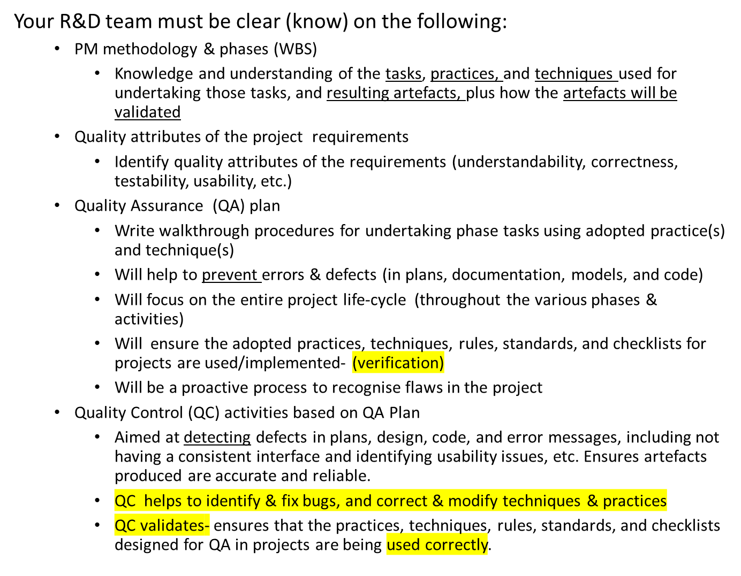
Ways to ensure quality in your R & D project
Notes:
Code Inspection - Inspectors' Training <CIIT.ppt>
© 1996 A. Winsor Brown BES/MSEE
What are we here for?
These are the instructors' expectations for the course.

Slide 5
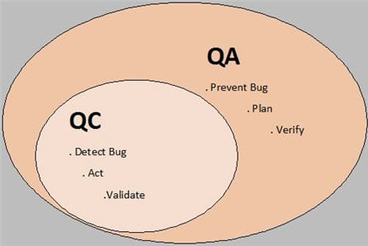
Ways to ensure quality in your R & D project
QA vs. QC
Notes:
Code Inspection - Inspectors' Training <CIIT.ppt>
© 1996 A. Winsor Brown BES/MSEE
What are we here for?
These are the instructors' expectations for the course.

Slide 6
Ways to ensure quality in your R & D project
Quality Attributes of the functional and non-functional requirements
Understandability
Correctness
Testability
Learnability
Usability
Reliability
Portability
Efficiency
Maintainability
Security
Flexibility
Which ones are relevant for your R & D project?
Notes:
Code Inspection - Inspectors' Training <CIIT.ppt>
© 1996 A. Winsor Brown BES/MSEE
What are we here for?
These are the instructors' expectations for the course.

Slide 7
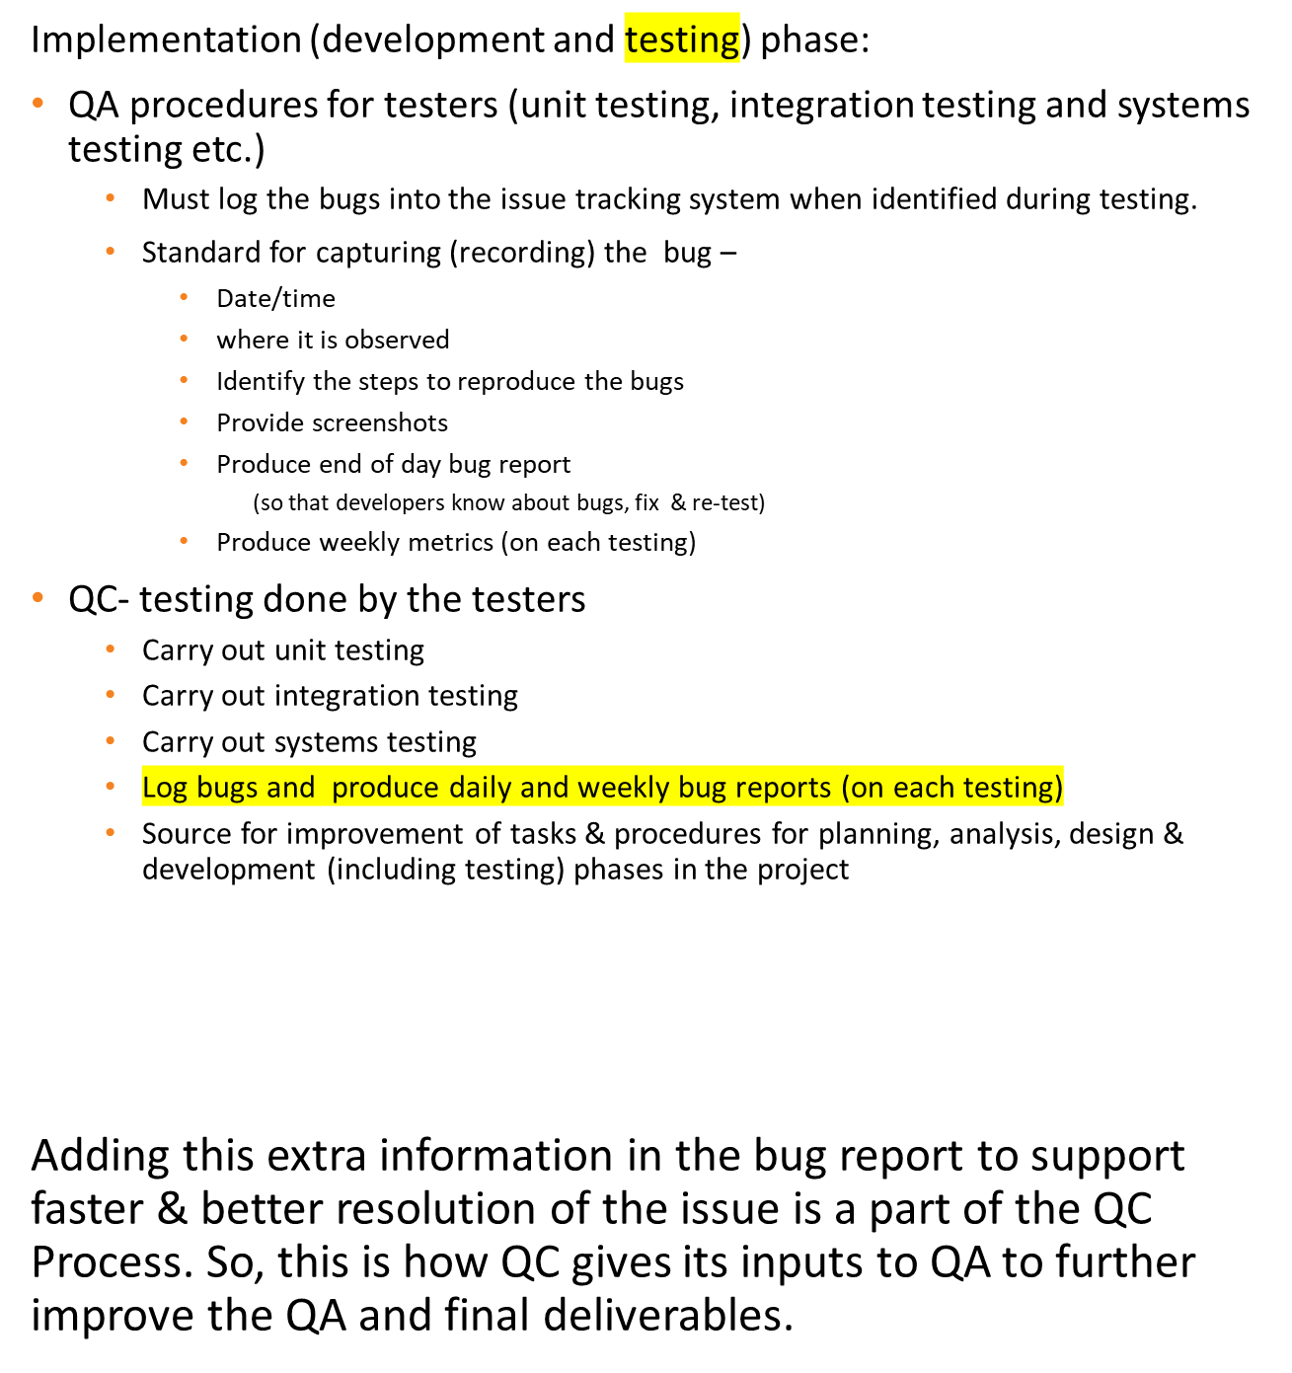
Examples of QA & QC
Notes:
Code Inspection - Inspectors' Training <CIIT.ppt>
© 1996 A. Winsor Brown BES/MSEE
What are we here for?
These are the instructors' expectations for the course.

Slide 8
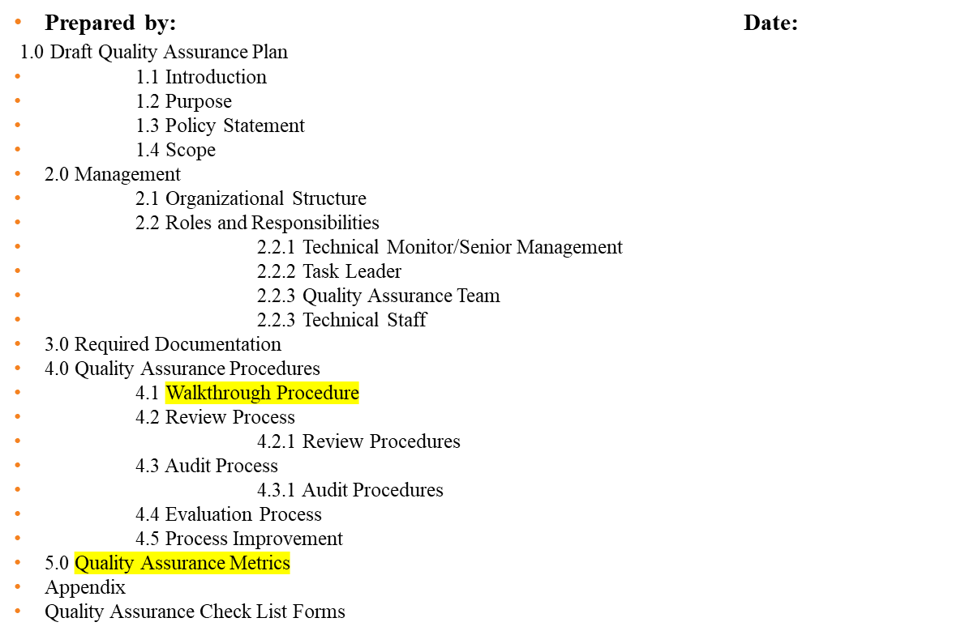
QA plan- PMI Template
Notes:
Code Inspection - Inspectors' Training <CIIT.ppt>
© 1996 A. Winsor Brown BES/MSEE
What are we here for?
These are the instructors' expectations for the course.

Slide 9
QA plan- adapted for R & D project
Quality Assurance Plan
1. Quality assurances walkthrough procedures for project phases
Planning phase
Analysis
Design
Implementation
  refer to slide 8
4. Quality Assurance Metrics
refer to slides 7 & 8
5. Appendix (identify the items that must be used as a template or checklist)
Templates and checklist
Notes:
Code Inspection - Inspectors' Training <CIIT.ppt>
© 1996 A. Winsor Brown BES/MSEE
What are we here for?
These are the instructors' expectations for the course.

Slide 10
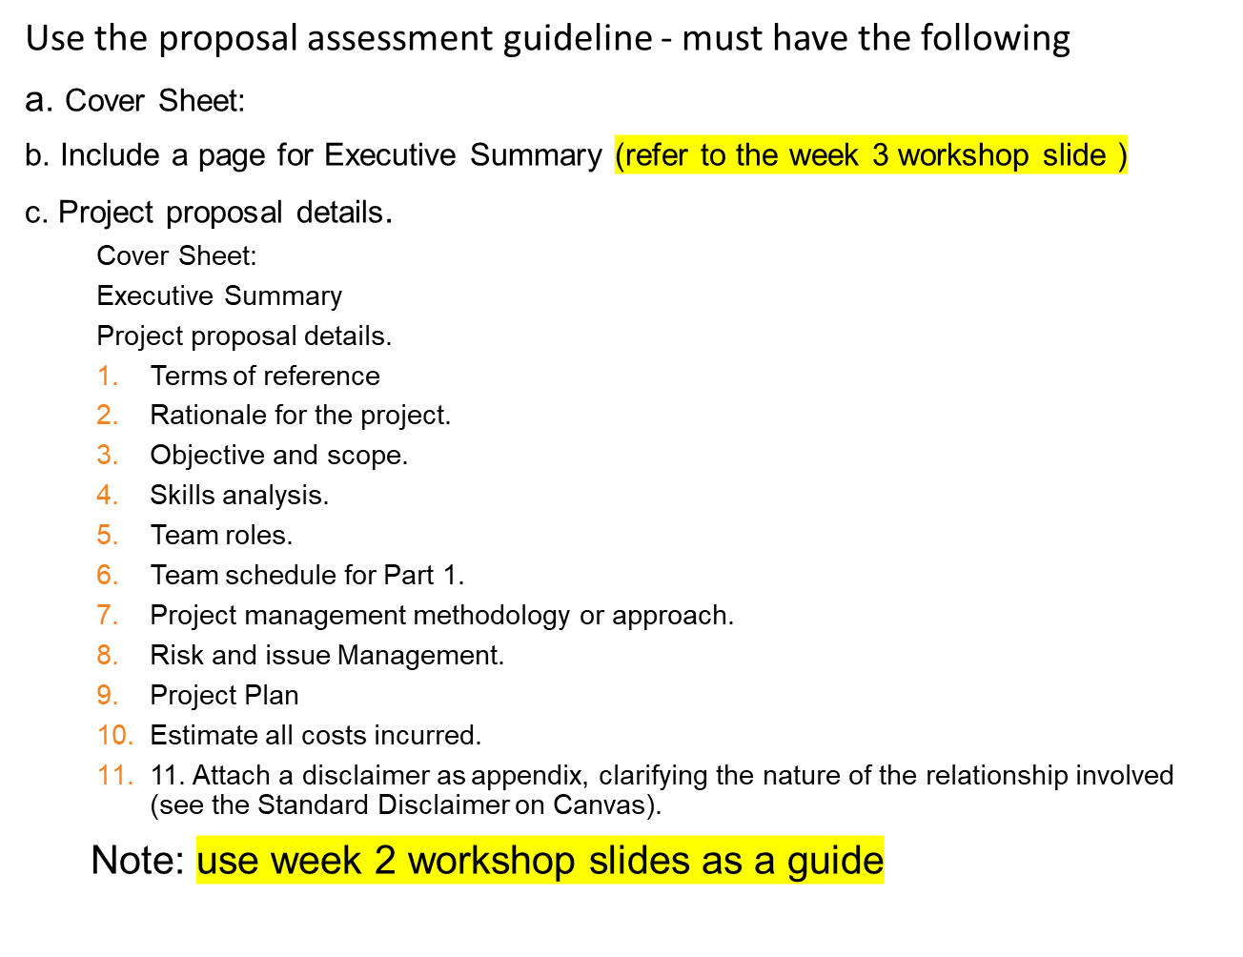
Proposal- due end of week 5 (on Canvas)

Slide 11
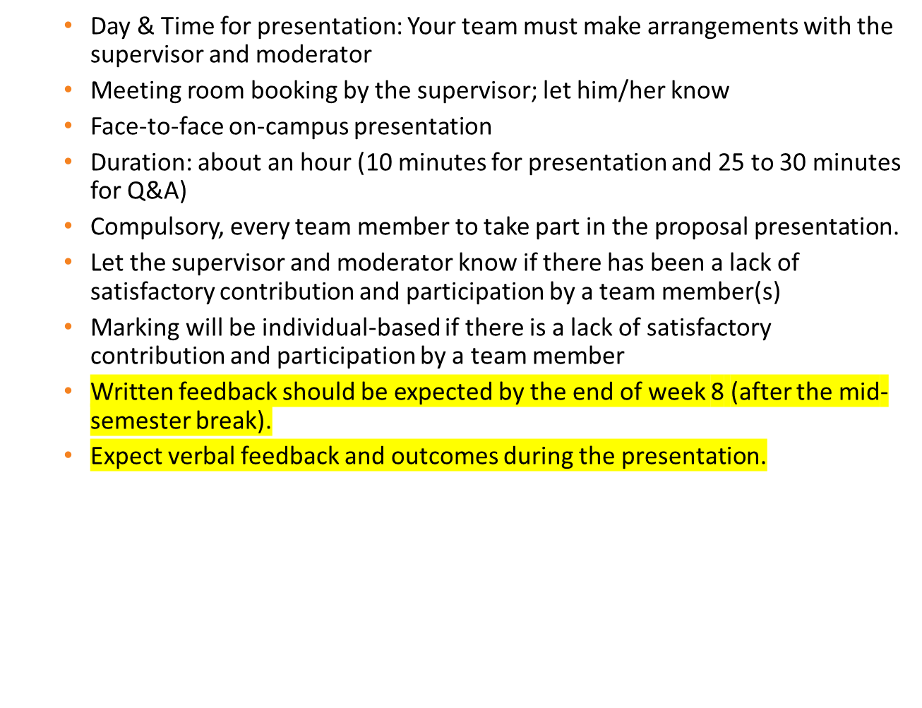
Proposal presentation - due week 6

Slide 12
Proposal presentation guide
Everyone must be familiar with the proposal content
  Defend your proposal
Dress smart
Must be ready to start the presentation on time
Get permission to record your presentation
10 minutes for presentation
  No more than 7 slides (use bullet points)
  Capture key points on which the team will talk
  Include issues/challenges faced so far
  Highlighted some key risks that may emerge during the project timeline
  Everyone must talk
25 to 30 minutes for Q/A. Help your team member to answer questions
  Q/A- if you can’t answer a question ask someone in the team to answer it. Don’t make up, just say we or I did not consider it for the proposal. (Truthful, take criticisms and take suggestions on board to get better).
Take notes on suggestions. Get clarification and ask questions.

Slide 13
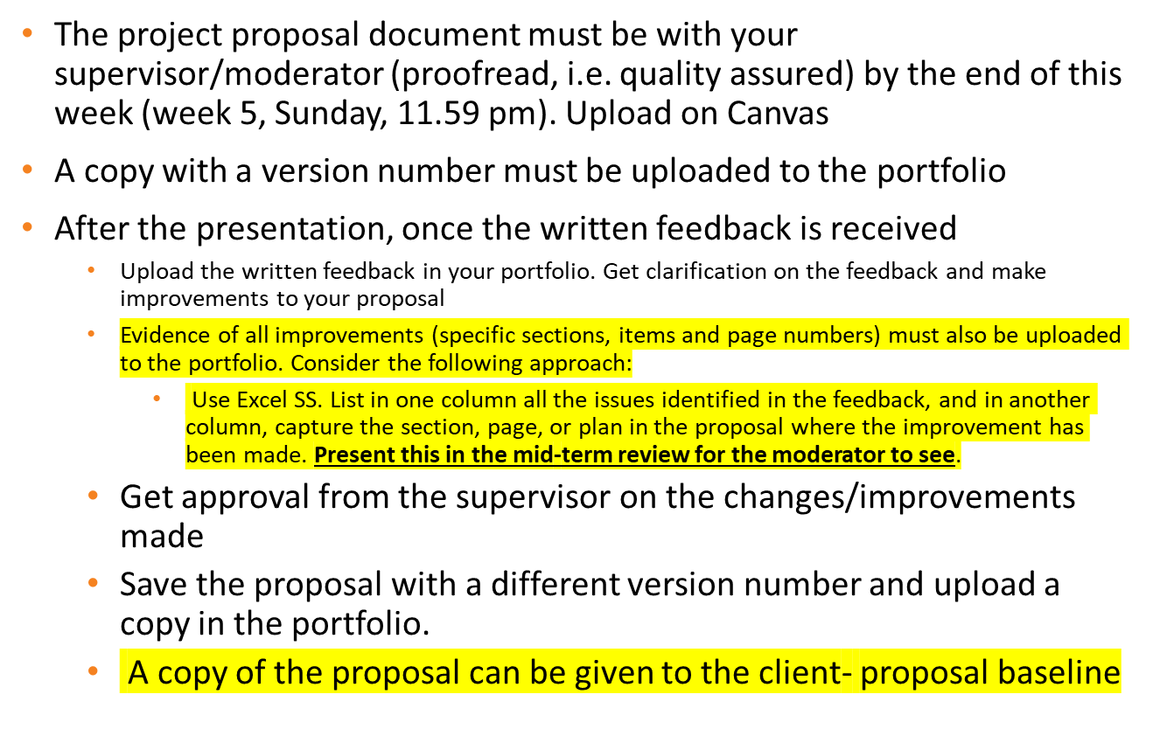
Proposal- Presentation in Week 6

Slide 14
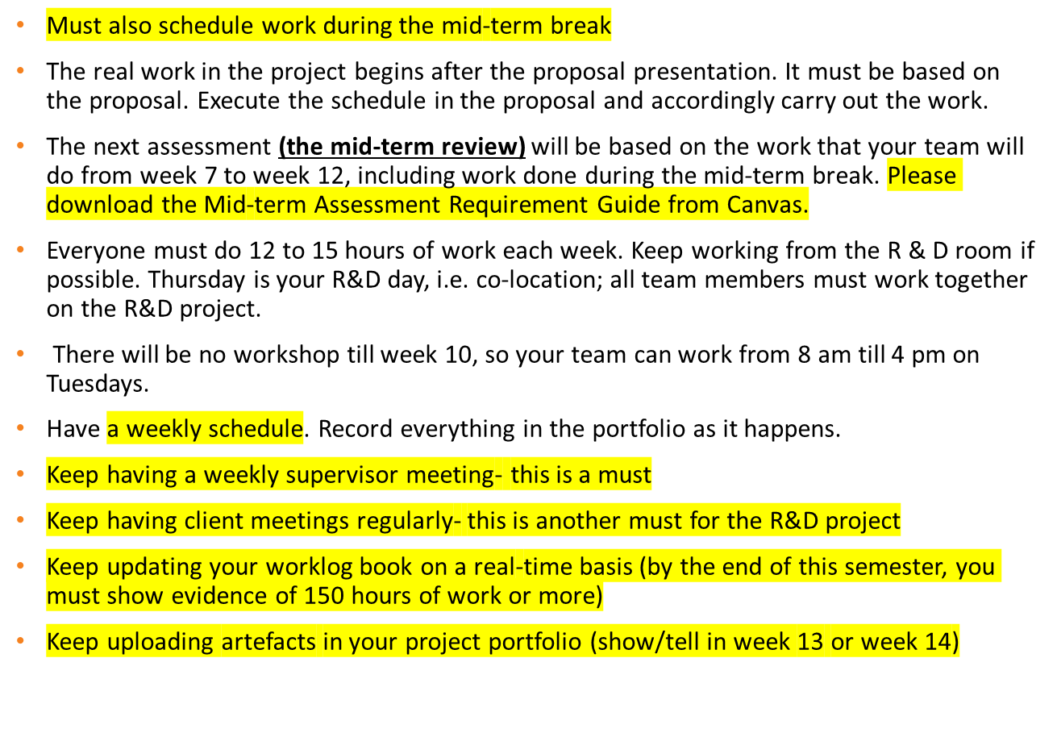
R & D work- weeks 7 to 12

Slide 15
Time management
Read the slides on time management
  Must become a self-organizing team for the entire duration of the project.
  From now onwards your team is expected to follow (execute & M/C) the project proposal to do the project work.
Good luck for your proposal presentation next week.
Questions?

